Slide 1

Text-to-Image Metamorphosis using GANs
Nikunj Lad - 001422467
ritu Agrawal - 001814874
Akhilesh tawde - 001425605

Slide 2
Project Agenda
Problem Statement
Dataset
Literature Review of related work
Architecture
Approach
Code
Results
Performance Evaluation
Conclusion
Future Scope
References

Slide 3
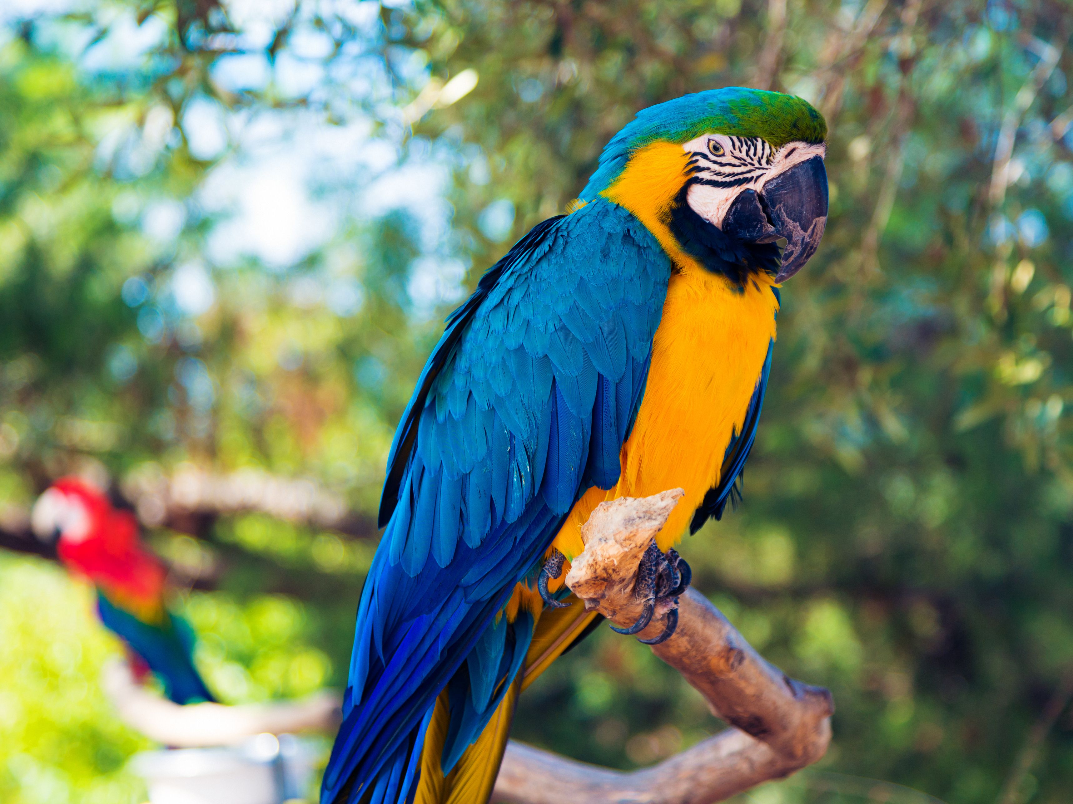
Problem Statement
The project aims to synthesize images given text image captions.
Input = Text description (e.g. image caption)
Output = Image (generally RGB)
Input = A bird with orange body and blue feathers
There have been lot of work in this direction but we choose one of the most accepted algorithm capable of producing state-of-the-art performance.
Output

Slide 4
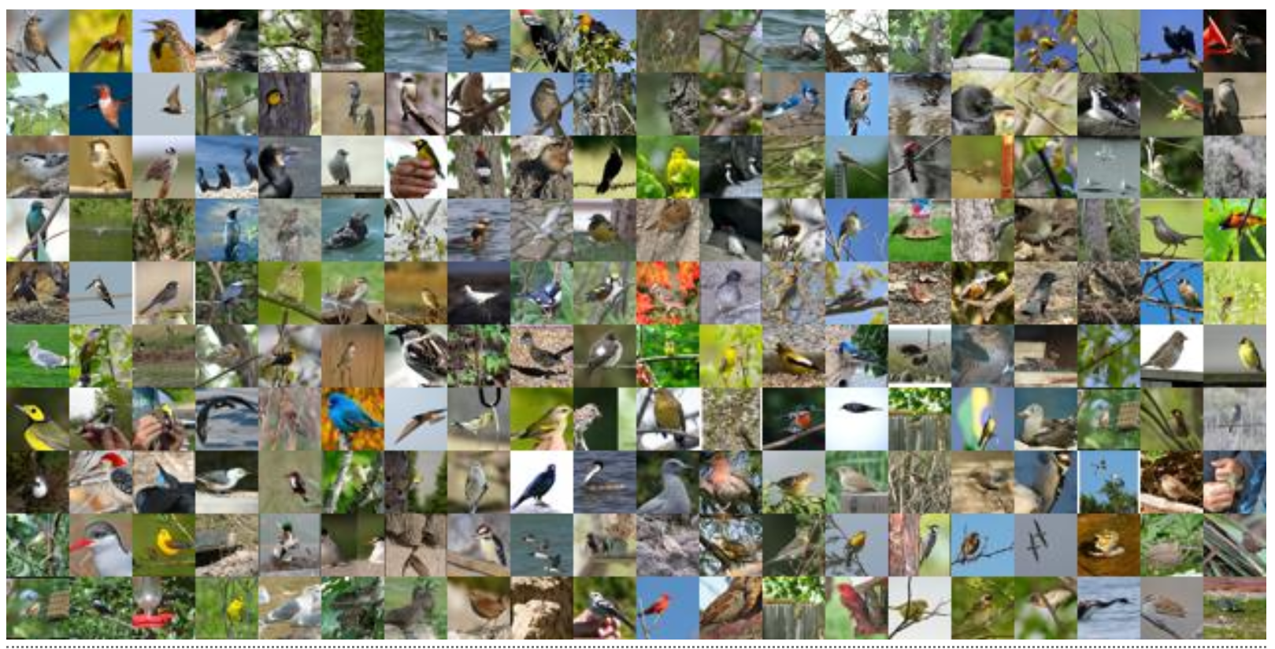
Birds Dataset

Slide 5
Birds Dataset
Caltech-UCSD Birds-200-2011 (CUB-200-2011) is an extended version of the CUB-200 dataset, with roughly double the number of images per class and new part location annotations.
Number of categories: 200
Number of images: 11,788
Annotations per image: 15 Part Locations, 312 Binary Attributes, 1 Bounding Box

Slide 6
Literature Review
Generative Adversarial Network by Ian J. Goodfellow
In GAN we must train two models:
Generator model(G) - that captures the data distribution
Discriminative model(D) - that tells the probability of the image belonging to the training set.
The training procedure for the G is to increase the probability of D making a mistake.
If multilayer perceptron's are chosen for G and D, backpropagation and dropouts can be used for training the entire system.
The samples are created by the generative model using the forward propagation.

Slide 7
Literature Review
Deep Learning is successful in discriminative models where it tries to map high dimensional, rich sensory input to a class label.
This is difficult in terms of Generative models because: Firstly, It is difficult to track the probability distribution and secondly, it is difficult to leverage the benefits of piecewise linear units.
In this type of model structure, the G is pitted against D and both try to learn to produce the best results.
The main advantage of GAN is it sidesteps the above difficulties.

Slide 8
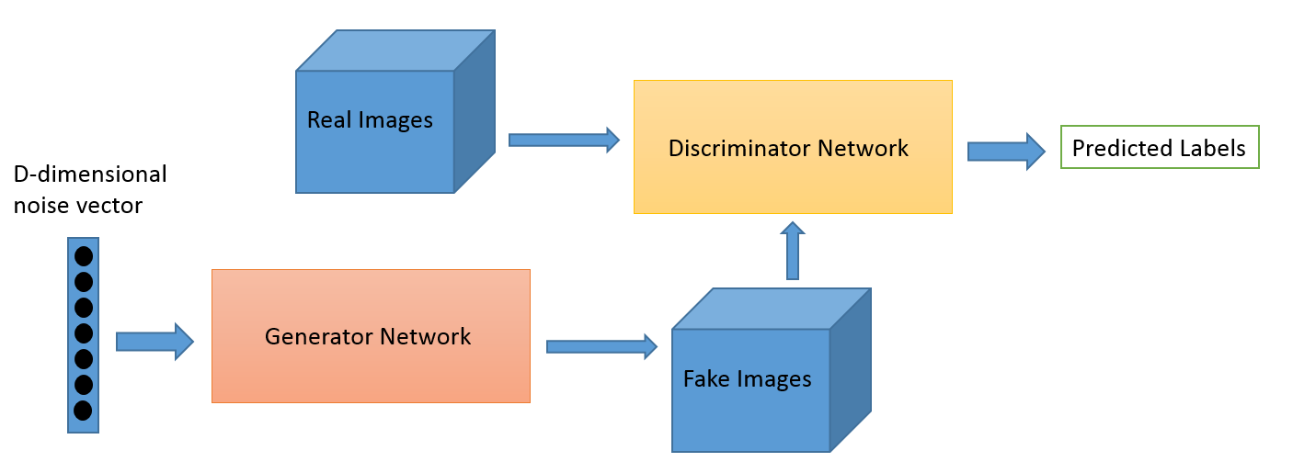
GAN Architecture

Slide 9
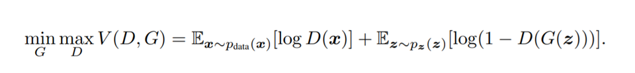
D(x) is the discriminator's estimate of the probability that real data instance x is real.
E_{x} is the expected value over all real data instances.
G(z) is the generator's output when given noise z.
D(G(z)) is the discriminator's estimate of the probability that a fake instance is real.
E_{z} is the expected value over all random inputs to the generator (in effect, the expected value over all generated fake instances G(z)).
The formula derives from the cross-entropy between the real and generated distributions.

Slide 10
AttnGAN- by Tao Xu et al
The paper was presented at CVPR 2018, the key conference on computer vision.
This architecture consists of two novel components-
Attentional generative network:
a global sentence vector is utilized to generate a low-resolution image in the first stage; a regional image vector is combined with the corresponding word-context vector to generate new image features in the surrounding subregions.
Deep Attentional Multimodal Similarity Model (DAMSM):
that computes the similarity between the generated image and text description, providing an additional fine-grained image-text matching loss for training the generator.

Slide 11
Architecture
Motivation:
The problem may seem like an encoder-decoder problem, but the paper tries to turn this to Sequence-to-Sequence problem.
The architecture generates images in m-stages where m is the number of generators and discriminators.
Leverages the Attention architecture which is a Sequence to Sequence architecture.
Incorporates a component in the architecture that looks after text and image alignment.

Slide 12
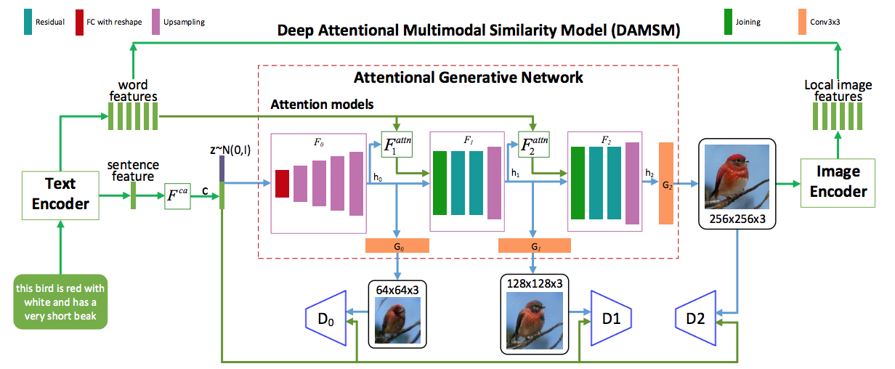
Architecture

Slide 13
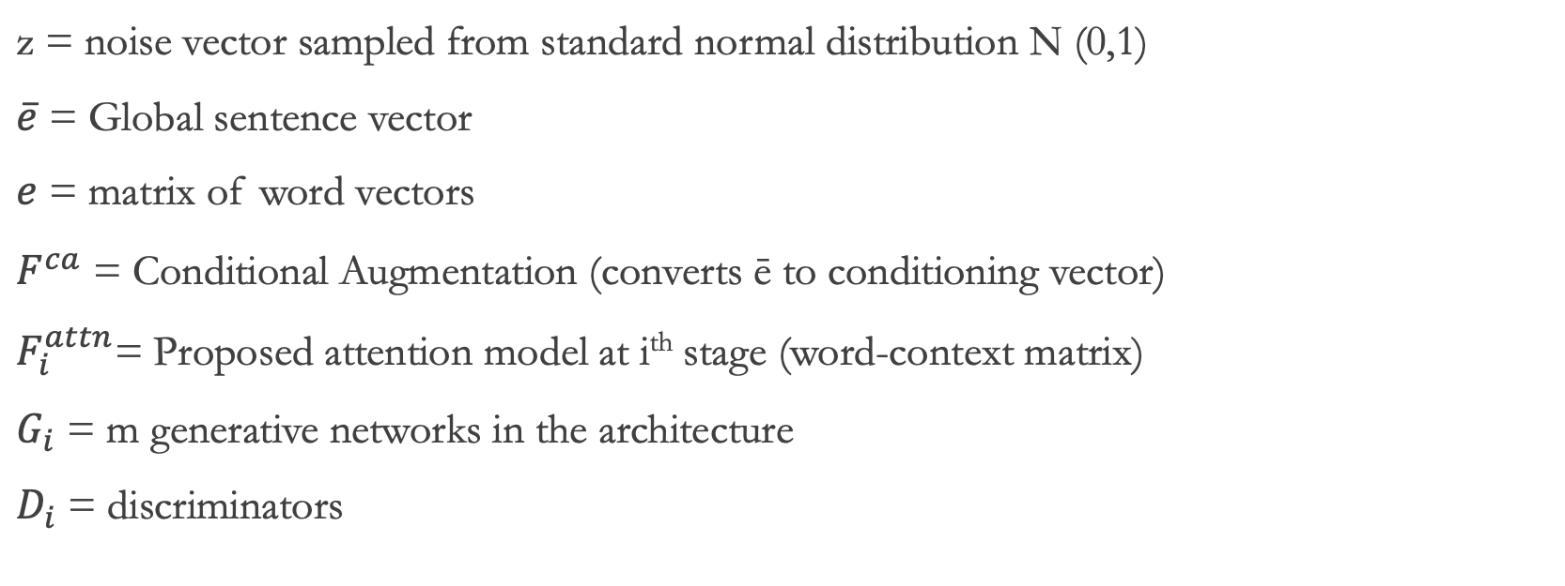
Notations
$\text{z}$ = noise vector sampled from standard normal distribution N (0,1)
$\overline{e}$ = Global sentence vector
$e$ = matrix of word vectors
$F^{ca}$ = Conditional Augmentation (converts ē to conditioning vector)
$F_{i}^{attn}$= Proposed attention model at i^{th} stage (word-context matrix)
$G_{i}$ = m generative networks in the architecture
$D_{i}$ = discriminators

Slide 14
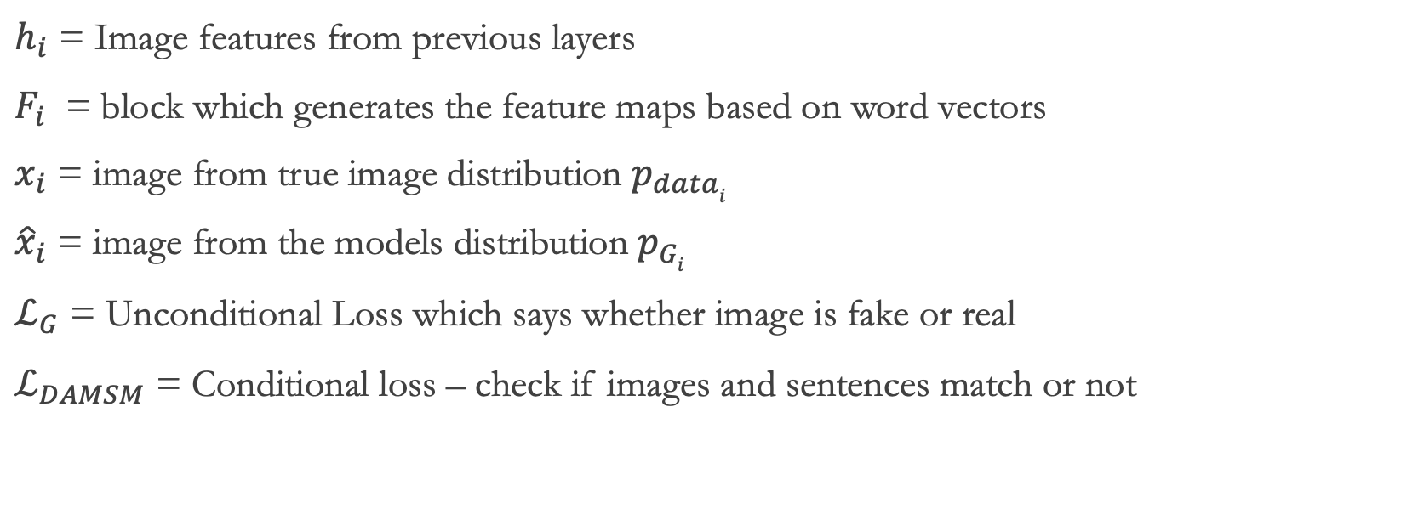
Notations
$h_{i}$ = Image features from previous layers
$F_{i}$ = block which generates the feature maps based on word vectors
$x_{i}$ = image from true image distribution $p_{datai}$
${\hat{x}}_{i}$ = image from the models distribution $p_{Gi}$
$ℒ_{G}$ = Unconditional Loss which says whether image is fake or real
$ℒ_{DAMSM}$ = Conditional loss – check if images and sentences match or not

Slide 15
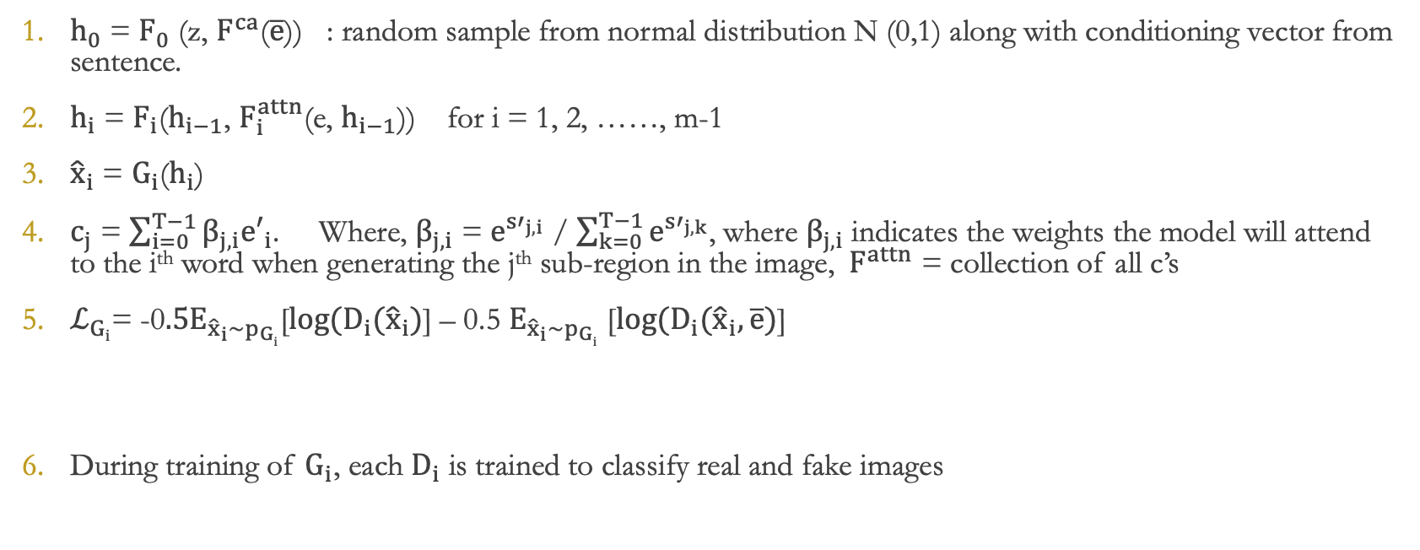
Mathematical Notations
$h_{0}$ = $F_{0}$ ($\text{z}$, $F^{ca}$($\overline{e}$)) : random sample from normal distribution N (0,1) along with conditioning vector from sentence.
$h_{i}$ = $F_{i}$($h_{i−1}$, $F_{i}^{attn}$($\text{e}$, $h_{i−1}$)) for i = 1, 2, ……, m-1
${\hat{x}}_{i}$ = $G_{i}$($h_{i}$)
$c_{j}$ = $\sum_{i=0}^{T−1}{β_{j,i}{e′}_{i}}$. Where, $β_{j,i}$ = $e^{{s′}_{j,i}}$ / $\sum_{k=0}^{T−1}{e^{{s′}_{j,k}}}$, where $β_{j,i}$ indicates the weights the model will attend to the i^{th} word when generating the j^{th} sub-region in the image,${ F}^{attn}$ = collection of all c’s
$ℒ_{Gi}$= -0$.5E_{{\hat{x}}_{i}\sim p_{Gi}}$[$\log{(D_{i}({\hat{x}}_{i})}$] – 0.5 $E_{{\hat{x}}_{i}\sim p_{Gi}}$ [$\log{(D_{i}({\hat{x}}_{i},\overline{e})}$]
During training of $G_{i}$, each $D_{i}$ is trained to classify real and fake images
Unconditional loss
Conditional loss

Slide 16
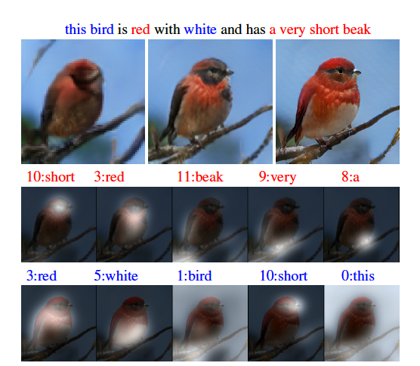
Components of Model
Text Encoder : bidirectional LSTM
Image Encoder: Built upon Inception-v3 model pretrained on ImageNet
c = region-context vector
s = sub-regions in the image

Slide 17

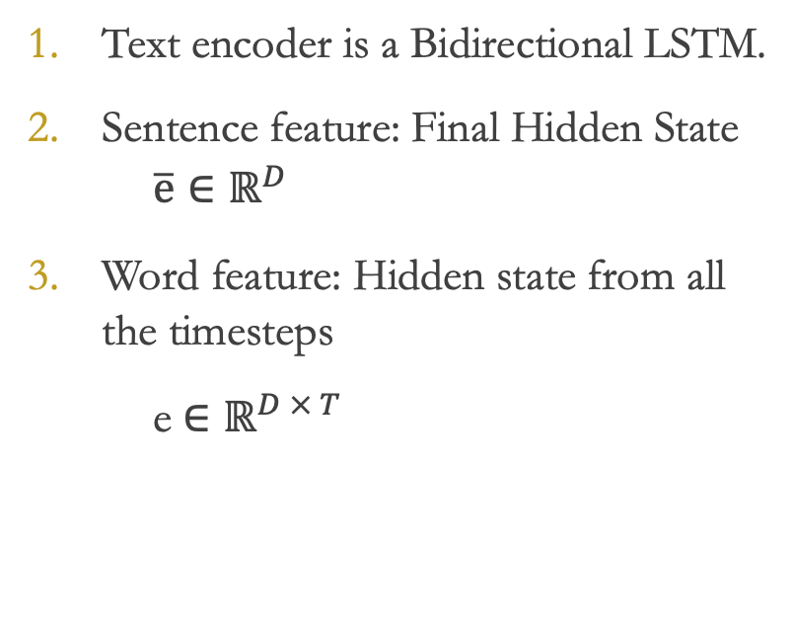
Text Encoder
Text encoder is a Bidirectional LSTM.
Sentence feature: Final Hidden State
$\overline{ⅇ}∈ℝ^{D}$
Word feature: Hidden state from all the timesteps
e $∈ℝ^{D × T }$

Slide 18
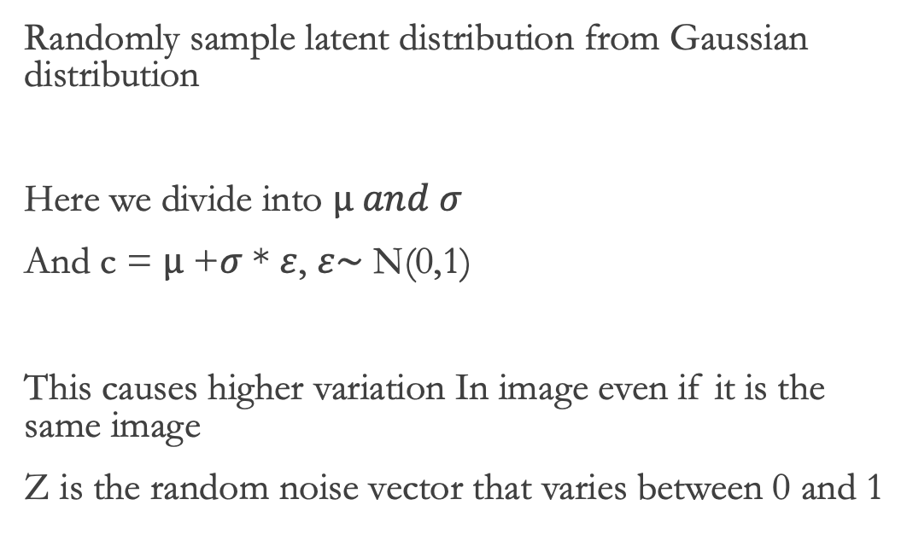
Conditional Augmentation
Randomly sample latent distribution from Gaussian distribution
Here we divide into $µ and σ$
And c = $µ$ +$σ$ * $ε$, $ε\sim$ N(0,1)
This causes higher variation In image even if it is the same image
Z is the random noise vector that varies between 0 and 1

Slide 19
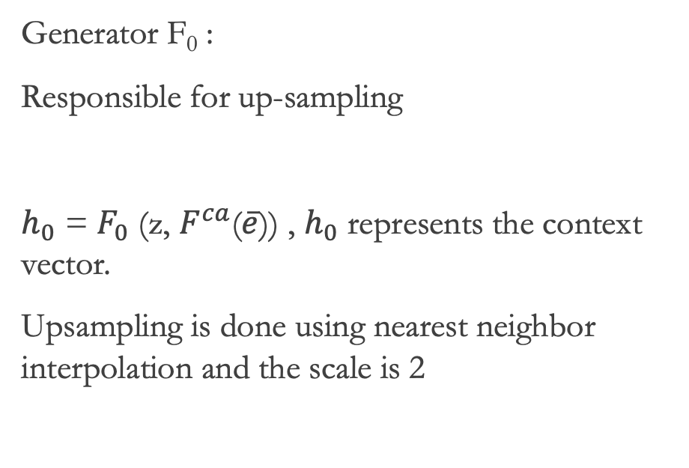
Generators
Generator F₀ :
Responsible for up-sampling
$h_{0}$ = $F_{0}$ ($\text{z}$, $F^{ca}$($\overline{e}$)) , $h_{0}$ represents the context vector.
Upsampling is done using nearest neighbor interpolation and the scale is 2
Residual
FC
Upsampling

Slide 20
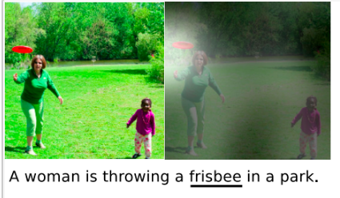
Attention model
Attention in NN’s is modeled after the way humans focus on a particular subset of their sensory input, and tune-out the rest.
It is employed in applications where you have a collection of data points, all of which may not be pertinent to the task at hand.
In such cases, attention is computed as a SoftMax-weighted average of all points in the collection.
The weight itself is computed as some non-linear function of the 1) vector-set and 2) some context.

Slide 21
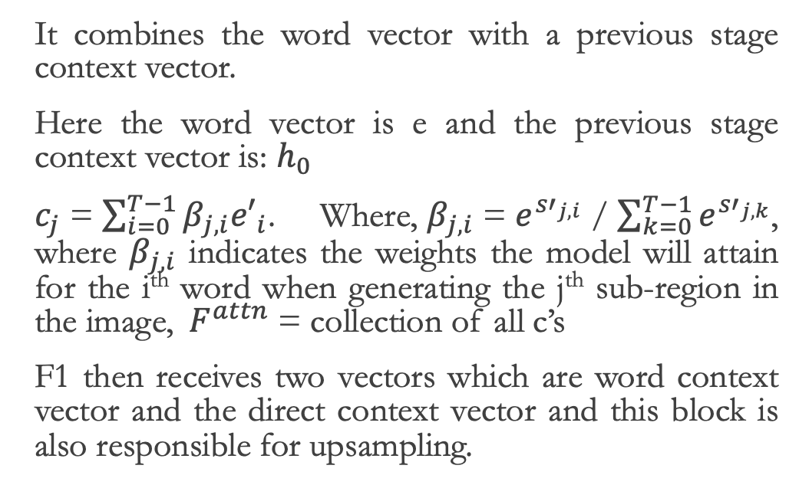
Attention model
It combines the word vector with a previous stage context vector.
Here the word vector is e and the previous stage context vector is: $h_{0}$
$c_{j}$ = $\sum_{i=0}^{T−1}{β_{j,i}{e′}_{i}}$. Where, $β_{j,i}$ = $e^{{s′}_{j,i}}$ / $\sum_{k=0}^{T−1}{e^{{s′}_{j,k}}}$, where $β_{j,i}$ indicates the weights the model will attain for the i^{th} word when generating the j^{th} sub-region in the image,${ F}^{attn}$ = collection of all c’s
F1 then receives two vectors which are word context vector and the direct context vector and this block is also responsible for upsampling.

Slide 22
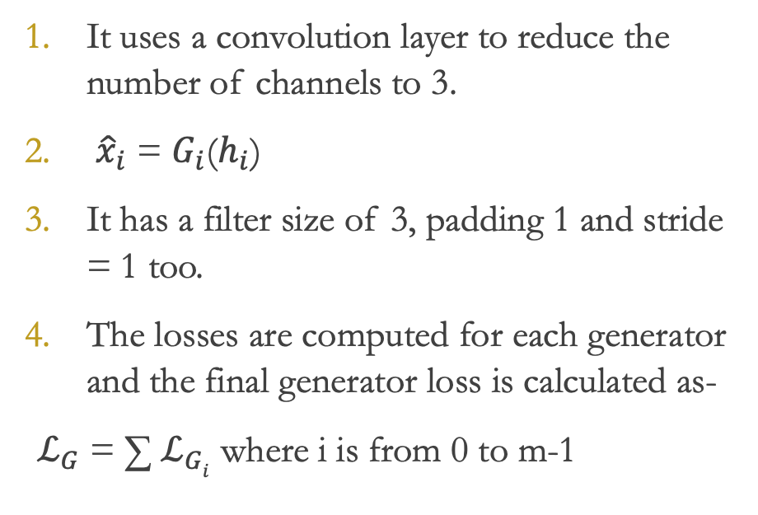
Generators- G₀, G₁, G₂
It uses a convolution layer to reduce the number of channels to 3.
${\hat{x}}_{i}$ = $G_{i}$($h_{i}$)
It has a filter size of 3, padding 1 and stride = 1 too.
The losses are computed for each generator and the final generator loss is calculated as-
$ℒ_{G}$ = ∑ $ℒ_{Gi}$ where i is from 0 to m-1

Slide 23
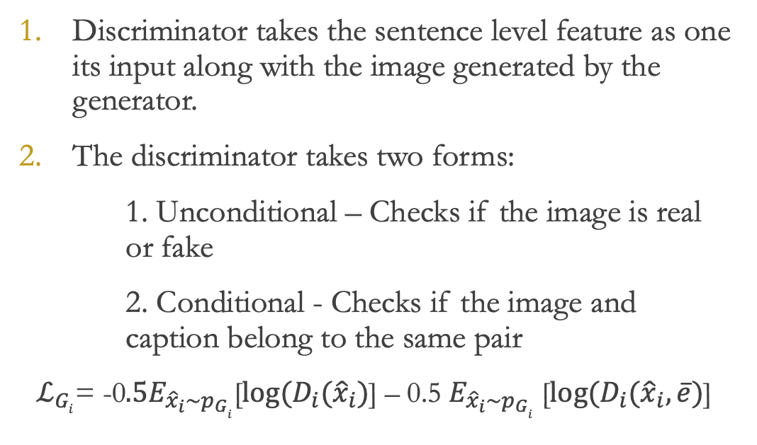
Discriminators – D₀, D₁, D₂
Discriminator takes the sentence level feature as one its input along with the image generated by the generator.
The discriminator takes two forms:
1. Unconditional – Checks if the image is real or fake
2. Conditional - Checks if the image and caption belong to the same pair
$ℒ_{Gi}$= -0$.5E_{{\hat{x}}_{i}\sim p_{Gi}}$[$\log{(D_{i}({\hat{x}}_{i})}$] – 0.5 $E_{{\hat{x}}_{i}\sim p_{Gi}}$ [$\log{(D_{i}({\hat{x}}_{i},\overline{e})}$]
Unconditional loss
Conditional loss

Slide 24
Deep Attentional Multimodal Similarity Model (DAMSM)
DAMSM takes as input an image and the set [e], and provides feedback on how well the two ‘fit’ together. It does this as follows:
Using a standard Convolutional Neural Network
The dimensionality of the feature maps is made equal to that of the word embeddings, so that they can be treated as equivalent entities.
Based on each token in the caption, Attention is applied over the feature maps, to compute a weighted average of them. This attention-vector essentially represents the image’s abstraction of the token.
Finally, DAMSM is trained to minimize the difference between the above attention-vector (visual portrayal of the word) & the word-embedding (textual meaning of the word).

Slide 25
Code…
https://github.com/nikunjlad/Text-to-Image-Metamorphosis-using-GANs

Slide 26
Approach
To achieve the generation of images given image description or caption, we used a generative adversarial network.
This GAN architecture works in collaboration with a Text Encoder, that is, a bidirectional LSTM.
Then, one more component that checks if the images and its context are a match, this block is called as DAMSM.
This entire architecture is then coded in Pytorch.
Because the model requires higher computational efficiency, we have used Google Cloud Platform to run our model.

Slide 27
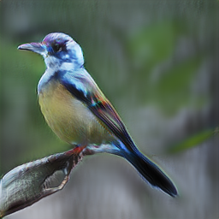
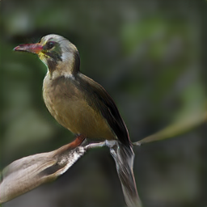
Results
We trained the network for 600 epochs with learning rate of 0.0002
Generator loss: 4.53 and Discriminator loss: 5.03
MirrorGAN implementation halted midway on server due to dimension error.
This bird has overall dark body color, and has a small white patch at the base of the beak.
this bird has a dark light overall body color, with long neck and short legs.

Slide 28
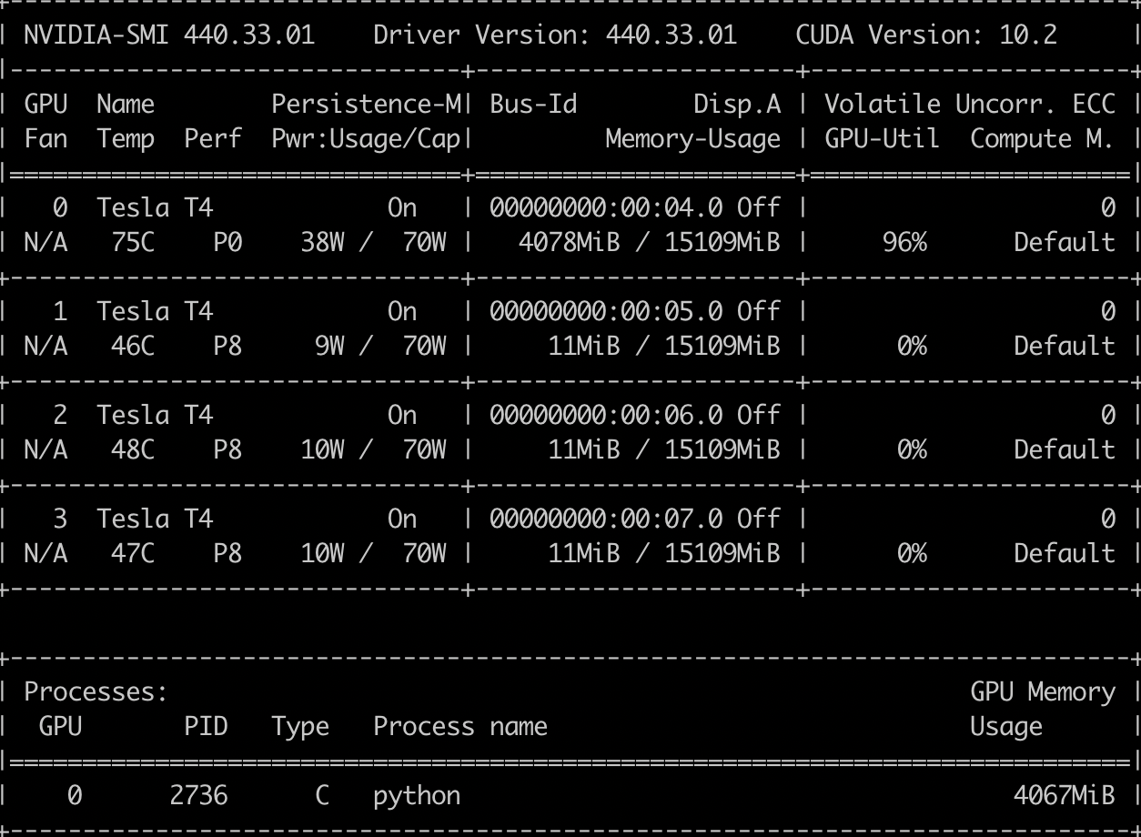
Performance Evaluation
Training took 14-15 hrs, using pretrained network.
The network consumed significant system resources due to the use of 4 models - rnn encoder, cnn encoder, generators and discriminators.
Used 1 Nvidia Tesla T4 for training on Google Cloud Instance.
About 4.5 GB of the 15gb of memory consumed for a Single GPU execution.

Slide 29
Things we added to the project
We implemented a multi-GPU training session to observe how training time can be reduced significantly by distributing computational load on multiple GPUs
We observed attentional maps of intermediate layers while training and saw the way the network was learning.
We added custom sentences and captions as part of model evaluation while changing number of epochs.
Most importantly, we not only implemented AttnGAN but also partially implemented MirrorGAN. Since MirrorGAN was introduced in 2019 and is new in the academic world, our model crashed on the server midway.

Slide 30
Conclusion
Thus, we conclude that the AttnGAN, is capable of learning text to generate fine grained images by paying attention to certain parts of the images considering certain parts of the text.
This project gave us an opportunity to learn the most recent innovation such as GAN and to also gain valuable knowledge about one important domain of deep learning which is Natural Language Processing.
To train models which have multiple sub architectures incorporated within them, it requires a high end, computationally efficient machine. This project gave us an opportunity of working with Google Cloud Platform and explore the cloud computing domain as well.
Last but certainly not the least, we thank Professor Dr. Subrata Das for giving us an opportunity to work in a team wherein we learnt the value of team work and how that can lead to the success of a project.

Slide 31
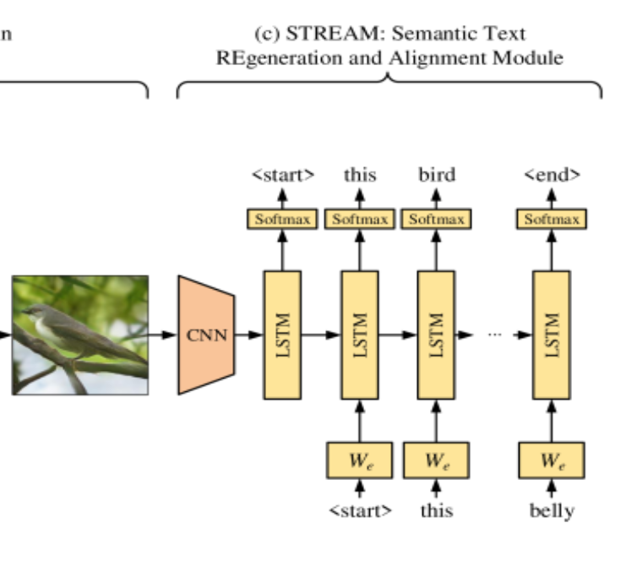
Future Scope
Working on MirrorGAN (STREAM Part)
Learning about RNN and LSTM
Regenerating Texts from Generated images for Text to Text matching
Regenerate the text description from the generated image, which semantically aligns with the given text description.

Slide 32
References
https://codeburst.io/understanding-attngan-text-to-image-convertor-a79f415a4e89
https://www.oreilly.com/library/view/generative-adversarial-networks/9781789136678/dde3cc74-b15c-4aef-b355-cdf17a7ae9c3.xhtml
https://towardsdatascience.com/illustrated-guide-to-lstms-and-gru-s-a-step-by-step-explanation-44e9eb85bf21
https://github.com/davidstap/AttnGAN
https://deephunt.in/the-gan-zoo-79597dc8c347
https://medium.com/jungle-book/towards-data-set-augmentation-with-gans-9dd64e9628e6

Slide 33
THANK YOU

